Slide 1


Early Disease Detection System using AI/ML
Submitted by:
Aekansh Khandelwal 21BCS8544
Parul Gogia 21BCS4234
Rishabh Raj 21BCS8350
Shubham 21BCS8726

Slide 2

Introduction to Early Disease Detection
An early disease detection system plays a crucial role in identifying health issues at an early stage, enabling timely intervention and treatment. It involves the analysis of medical imaging such as X-rays, MRIs, and CT scans to identify abnormalities and potential diseases. The system is designed to enhance patient outcomes by providing early diagnoses and personalized treatment plans. Medical professionals, including radiologists and specialists, work together to analyze the imaging results, ensuring a comprehensive approach to patient care and well-being.

Slide 3
Importance of Early Detection in Improving Improving Patient Outcomes
Early Intervention:
Early detection allows for timely intervention and treatment, which can significantly improve patient outcomes and prognosis.
Personalized Care:
Timely detection enables the customization of treatment plans, ensuring patients receive personalized and effective medical care.
Reduced Mortality:
Timely identification of diseases can lead to reduced mortality rates, providing better chances for successful treatments.

Slide 4
Objectives
Early Identification:
The primary objective is to achieve early identification of potential health issues through the analysis of medical imaging.
Accurate Diagnosis:
Ensuring accurate and precise diagnosis based on the analysis of medical imaging to provide the best possible treatment options.
Patient Education:
Educating patients about the importance of regular health check-ups and the role of medical imaging in early disease detection.

Slide 5
Types of Medical Imaging Used in Early Disease Detection
X-rays:
X-rays are commonly used to detect bone fractures and abnormalities, providing a quick and non-invasive diagnostic tool.
MRI (Magnetic Resonance Imaging):
MRI scans provide detailed images of soft tissues and are effective in detecting conditions such as tumors and neurological diseases.
CT (Computed Tomography):
Scans CT scans produce cross- sectional images of the body, allowing the identification of conditions like internal bleeding and lung diseases

Slide 6
Role of Artificial Intelligence in Analyzing Analyzing Medical Imaging
Enhanced Analysis: Al algorithms can analyze large volumes of medical imaging data, enabling quicker and more accurate detection of abnormalities and patterns.
Efficient Diagnosis: Al technology assists radiologists and specialists in interpreting complex imaging results, leading to more efficient diagnosis and treatment planning.
Precision Medicine: Al contributes to the development of personalized treatment plans based on the analysis of medical imaging, ensuring tailored care for each patient

Slide 7
Methodology
Data Collection:
Gather relevant datasets and sources for Al training.
Model Training:
Develop and fine-tune AI/ML models for disease identification.
Validation:
Test the model's performance and validate results for accuracy.

Slide 8
Features for Early Disease Detection
1.Biometric Data: Includes heart rate, ECG, and neurophysiological signals for analysis.
2.Medical Imaging: Utilize X-rays, MRI, and CT scans for disease identification.
3.Genetic Markers: Identify specific genes responsible for certain diseases and tendencies

Slide 9



Analysis of AI/ML Techniques
Supervised Learning:
Use labeled data to train the Al model.
Unsupervised Learning:
Allow the model to discover patterns without labeled data.
Ensemble Techniques:
Combine multiple models for enhanced accuracy and robustness.

Slide 10
Analysis of Features
Usability:
Evaluate the user-friendliness and accessibility of the system.
Scalability:
Analyze if the system can handle increased data and usage demands.
Interoperability:
Assess the system's ability to integrate with various healthcare technologies.
Reliability:
Determine the consistency and accuracy of disease detection results

Slide 11
Constraint Identification
Data Availability:
Access to large, high-quality datasets is critical for training robust Al/ML models.
Regulatory Approval:
Al-powered diagnostic tools must meet stringent clinical validation and safety requirements before deployment.
Interpretability:
Developing transparent, explainable Al systems is important for building trust in medical applications.
Ethical Considerations:
Careful planning is needed to ensure Al systems are unbiased and respect patient privacy and consent

Slide 12
Design Selection
Integration:
Seamless integration with existing clinical workflows and EHR systems.
Scalability:
Ability to handle growing data volumes and diverse patient populations.
User-Friendly:
Intuitive interfaces and decision support tools for healthcare providers.
Security:
Robust data privacy and cybersecurity measures to protect patient information.

Slide 13
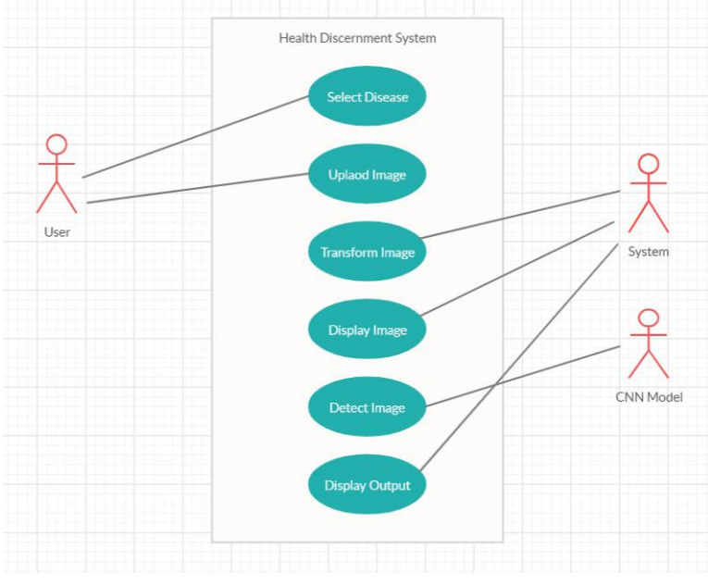
Preliminary Design

Slide 14
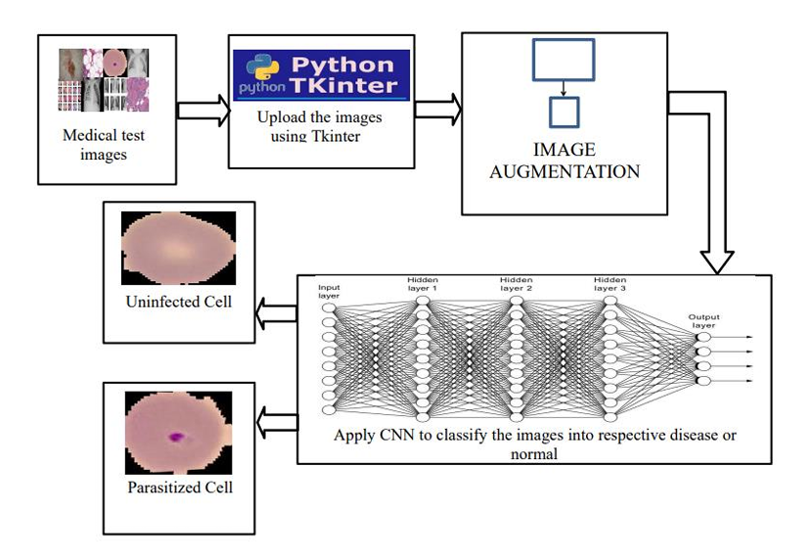
Graphical Representation

Slide 15
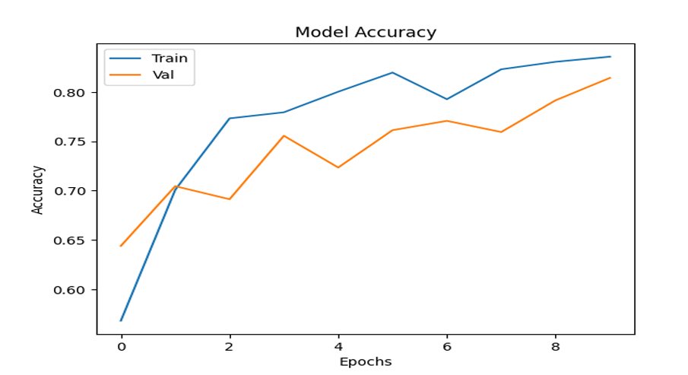
Result and Output
Decent accuracy of 83.18 is achieved with CNN Model

Slide 16
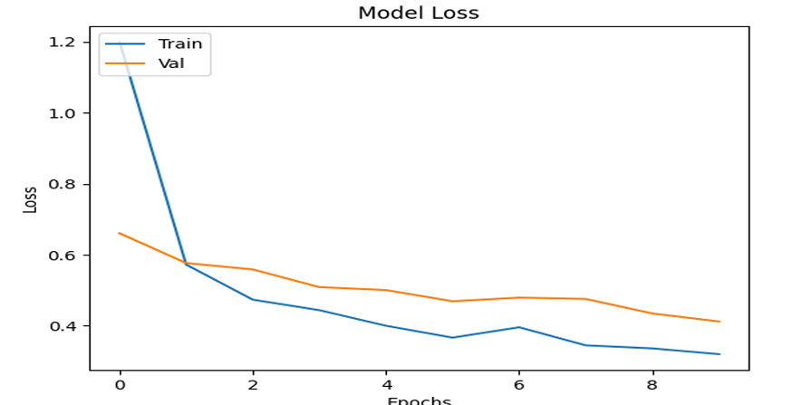
Result and Output

Slide 17
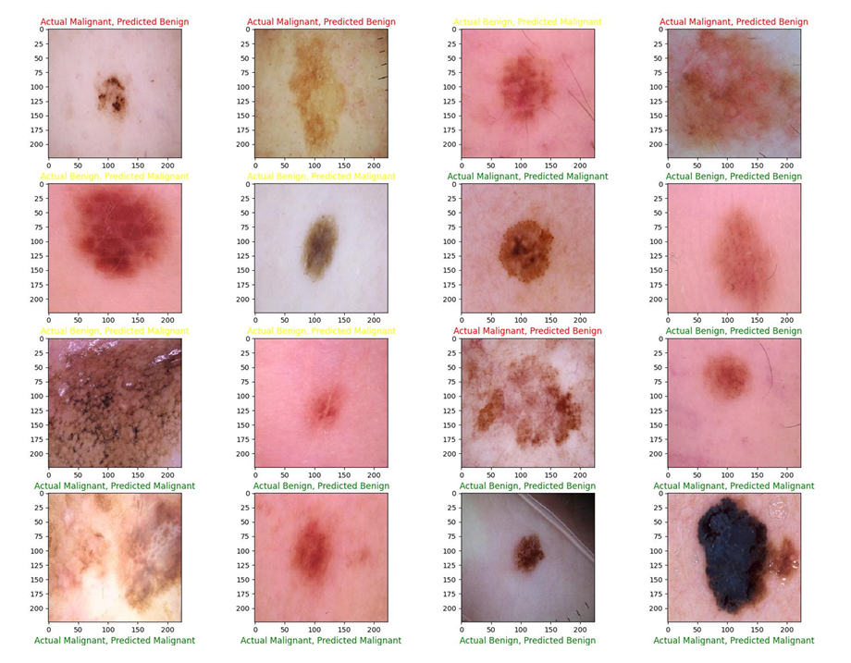
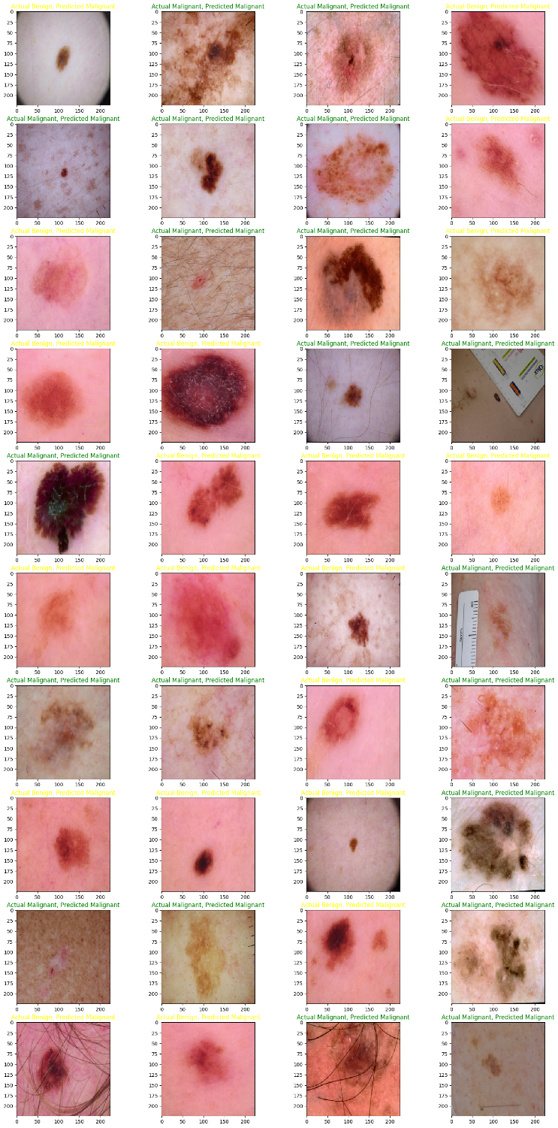
Result and Output

Slide 18
Result and Output

Slide 19
Result and Output
Green tile means correction prediction.
01
Yellow tile means incorrect prediction of benign cancer as malignant.
02
Red tile means incorrect prediction of malignant cancer as benign.
03

Slide 20
Benefits of Using an Early Disease Detection System
Improved Patient Outcomes:
Early detection leads to improved patient outcomes, providing better chances for successful treatment and recovery.
Cost-Effective Care:
Timely detection of diseases can lead to cost-effective healthcare by preventing the progression of advanced and more expensive treatments.
Enhanced Disease Management:
Early detection allows for more effective disease management, reducing the impact and severity of health conditions.

Slide 21
Challenges and Limitations of Early Disease Disease Detection through Medical Imaging Imaging
False Positives: One of the limitations is the occurrence of false-positive results, leading to unnecessary follow-up procedures and anxiety for patients.
Equipment Limitations: Challenges related to the availability and quality of imaging equipment can Impact the accuracy of early disease detection.
Interpretation Complexity: The complexity of Interpreting certain imaging results can pose challenges for healthcare professionals, affecting timely diagnoses.

Slide 22
Conclusion
In conclusion, early disease detection through medical imaging significantly improves patient outcomes, assists in personalized treatment planning, and leads to more efficient disease management. While there are challenges to overcome, the benefits and positive impact of timely diagnoses are undeniable, emphasizing the importance of continued advancements in this critical area of healthcare

Slide 23
Future Scope
The future scope of early disease detection using AI/ML is vast and holds tremendous potential for transformative impact across various domains. Here are some key areas of future exploration and development:
Integration of Multi-omics Data: Incorporating multi-omics data, including genomics, 61 proteomics, metabolomics, and imaging data, can provide a comprehensive understanding of disease mechanisms and enable more accurate predictive modeling. Integrating diverse data modalities using advanced AI techniques promises to unlock new insights into disease etiology, progression, and personalized treatment strategies.
Real-time Monitoring and Surveillance: Expanding AI-driven early disease detection systems to enable real-time monitoring and surveillance of population health. By leveraging wearable devices, remote sensors, and electronic health records, AI algorithms can continuously analyze health data streams to identify early warning signs of disease outbreaks, epidemics, or individual health deterioration, enabling proactive interventions and public health interventions.

Slide 24
References
[1] Smith, B. D., & Smith, G. L. (2020). Early Detection of Disease Outbreaks Using Machine Learning Algorithms: A Review. Big Data and Cognitive Computing, 4(3), 22.
[2] Mathew, R., & Kothari, A. (2019). Early Disease Detection using Machine Learning. International Journal of Advanced Research in Computer Science, 10(2), 181-186.
[3] Wahid, F., Chen, Y., Niyato, D., & Kim, D. I. (2020). Early Disease Detection and Its Impact on Healthcare: A Review. IEEE Access, 8, 196456-196474.
[4] Moradinasab, M., & Alian, S. (2021). Early Detection of Chronic Diseases: A Comprehensive Review of Machine Learning Approaches. Healthcare Informatics Research, 27(1), 3-20.
[5] Kourou, K., Exarchos, T. P., Exarchos, K. P., Karamouzis, M. V., & Fotiadis, D. I. (2015). Machine learning applications in cancer prognosis and prediction. Computational and Structural Biotechnology Journal, 13, 8-17., A.
[6] Topol, E. J. (2019). High-performance medicine: the convergence of human and artificial intelligence. Nature Medicine, 25(1), 44-56.
[7] Cabitza, F., & Rasoini, R. (2017). Gaining insights from biomedical data through reuse, repurposing, and reproducibility. Artificial Intelligence in Medicine, 81, 1-2.
[8] Obermeyer, Z., & Emanuel, E. J. (2016). Predicting the Future—Big Data, Machine Learning, and Clinical Medicine. New England Journal of Medicine, 375(13), 1216-1219.
[9] Liu, X., Cruz Rivera, S., Moher, D., & Calvert, M. J. (2019). Improving the completeness of reporting of systematic reviews of diagnostic test accuracy: the QUADAS-2 checklist. British Medical Journal Open, 9(11), e031430.
[10] Haenssle, H. A., Fink, C., Schneiderbauer, R., Toberer, F., Buhl, T., Blum, A., ... & Uhlmann, L. (2018). Man against machine: diagnostic performance of a deep learning convolutional neural network for dermoscopic melanoma recognition in comparison to 58 dermatologists. Annals of Oncology, 29(8), 1836 1842. [11] Estev

